Slide 1
Shortest Path

Slide 2
The shortest path problem is about finding a path between 2 vertices in a graph such that the total sum of the edges weights is minimum.
This problem could be solved easily using (BFS) if all edge weights were (1), but here weights can take any value. There are different algorithms.
Single Source Shortest Path
Bellman Ford's Algorithm
Dijkstra's Algorithm
All-Pairs Shortest Path
Floyd–Warshall's Algorithm

Slide 3
Bellman Ford's Algorithm:
Bellman Ford's algorithm is used to find the shortest paths from the source vertex to all other vertices in a weighted graph. It depends on the following concept: Shortest path contains at most n−1 edges, because the shortest path couldn't have a cycle.
So why shortest path shouldn't have a cycle ? There is no need to pass a vertex again, because the shortest path to all other vertices could be found without the need for a second visit for any vertices.
Algorithm Steps:
The outer loop traverses from 0 : n−1.
Loop over all edges, check if the next node distance > current node distance + edge weight, in this case update the next node distance to "current node distance + edge weight".
This algorithm depends on the relaxation principle where the shortest distance for all vertices is gradually replaced by more accurate values until eventually reaching the optimum solution.
In the beginning all vertices have a distance of "Infinity", but only the distance of the source vertex = 0, then update all the connected vertices with the new distances (source vertex distance + edge weights), then apply the same concept for the new vertices with new distances and so on.

Slide 4
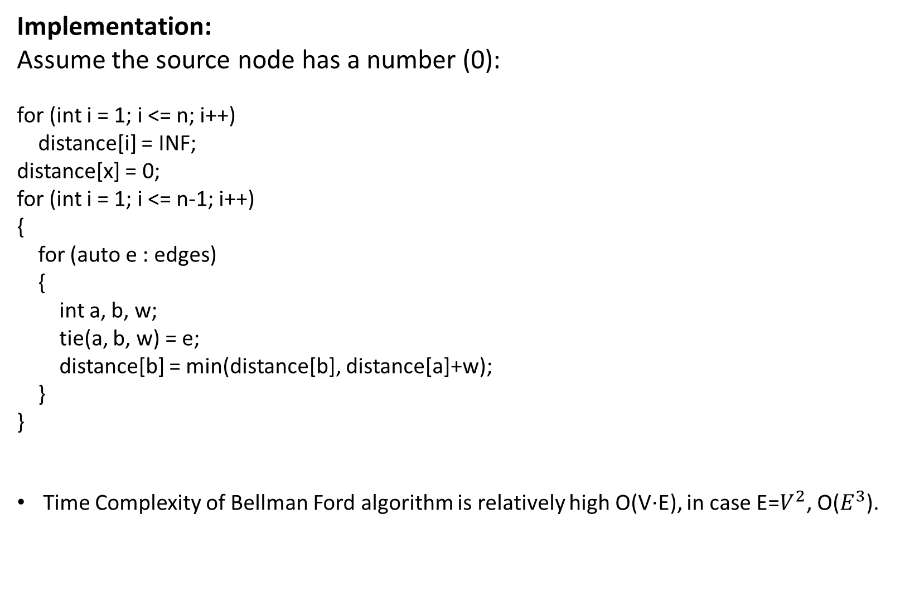

Slide 5
Dijkstra's Algorithm
Dijkstra's algorithm is to find the shortest paths from the source vertex to all other vertices in the graph.
Algorithm Steps:
Set all vertices distances = infinity except for the source vertex, set the source distance = 0.
Push the source vertex in a min-priority queue in the form (distance , vertex), as the comparison in the min-priority queue will be according to vertices distances.
Pop the vertex with the minimum distance from the priority queue (at first the popped vertex = source).
Update the distances of the connected vertices to the popped vertex in case of "current vertex distance + edge weight < next vertex distance", then push the vertex with the new distance to the priority queue.
If the popped vertex is visited before, just continue without using it.
Apply the same algorithm again until the priority queue is empty.

Slide 6
int N = 1000;
const int INF = std::numeric_limits<int>::max();
bool visited[N];
priority_queue<pair<int, int>> q;
vector<pair<int, int>> adj[N];
int distance[N];
void dijkastra(int x){
for (int i = 1; i <= n; i++)
distance[i] = INF;
distance[x] = 0;
q.push({0,x});
while (!q.empty())
{
int a = q.top().second;
q.pop();
if (visited[a])
continue;
visited[a] = true;
for (auto u : adj[a])
{
int b = u.first, w = u.second;
if (distance[a]+w < distance[b])
{
distance[b] = distance[a]+w;
q.push({-distance[b],b});
}
}
}
}

Slide 7
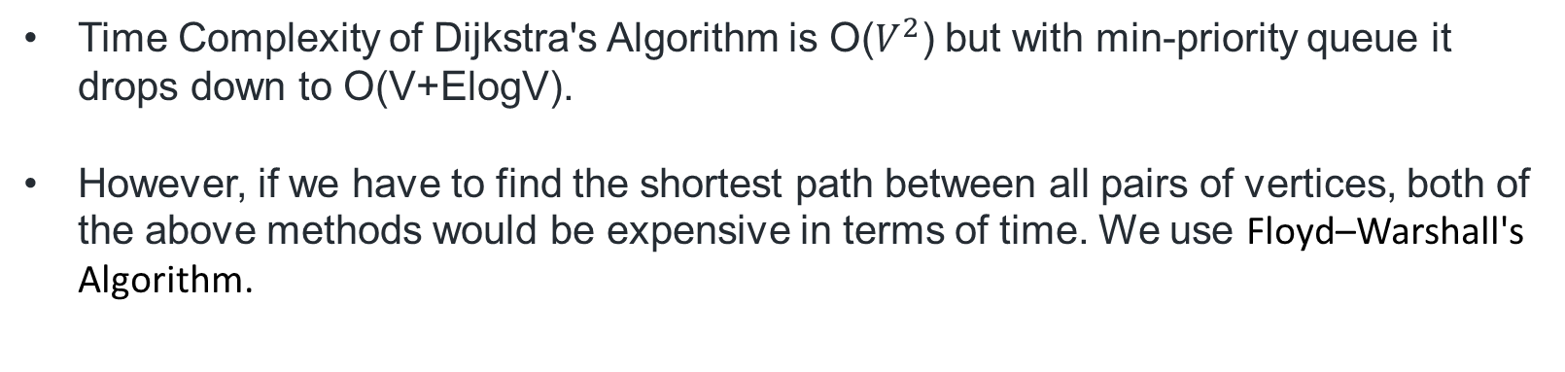

Slide 8
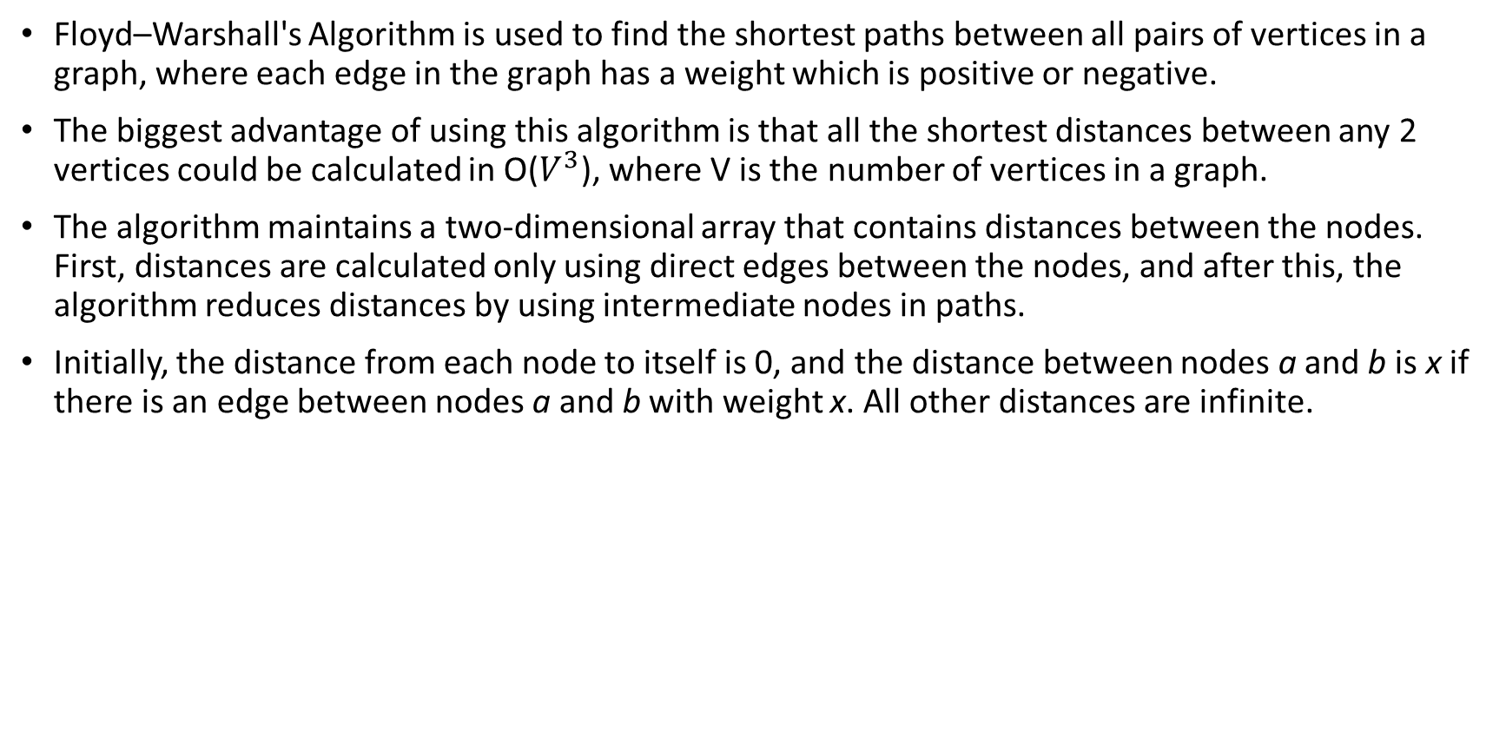
Floyd–Warshall's Algorithm

Slide 9
Implementation
The advantage of the Floyd–Warshall algorithm that it is easy to implement. The following code constructs a distance matrix where distance[a][b] is the shortest distance between nodes a and b.
First, the algorithm initializes distance using the adjacency matrix adj of the graph:
for (int i = 1; i <= n; i++)
{
for (int j = 1; j <= n; j++)
{
if (i == j)
distance[i][j] = 0;
else if (adj[i][j])
distance[i][j] = adj[i][j];
else
distance[i][j] = INF;
}
}

Slide 10
After this, the shortest distances can be found as follows:
for (int k = 1; k <= n; k++)
{
for (int i = 1; i <= n; i++)
{
for (int j = 1; j <= n; j++)
{
distance[i][j] = min(distance[i][j],
distance[i][k]+distance[k][j]);
}
}
}
Time Complexity of Floyd–Warshall's Algorithm is O(), where V is the number of vertices in a graph.

